Slide 1

Micro-services based architecture – a path to “Living Software”?
Jason Chambers
Director of Engineering

Slide 2
Observations

Slide 3
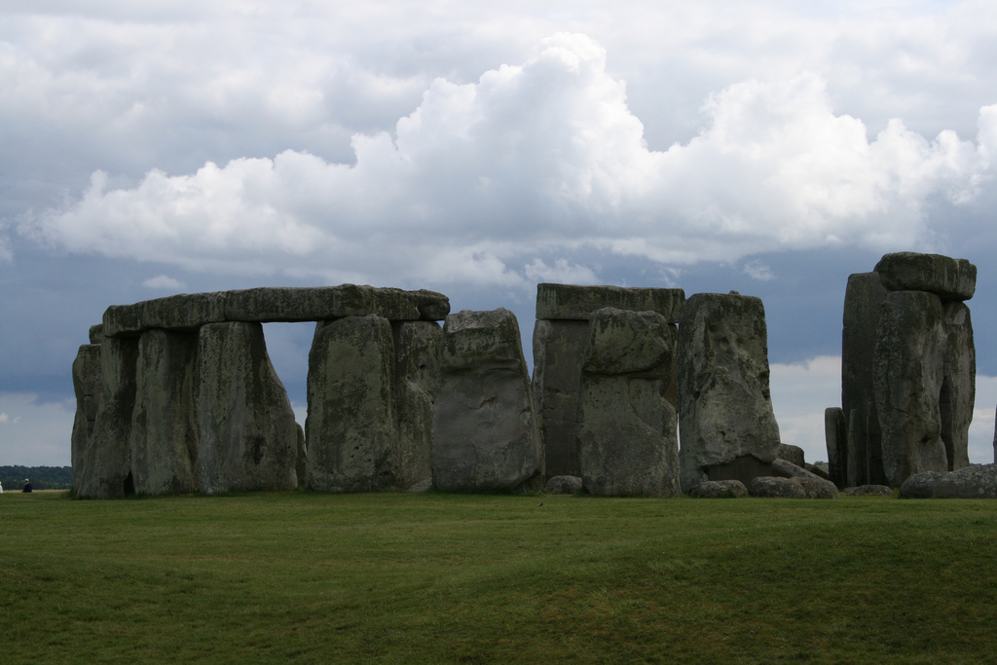
Notes:
This is Stonehenge. Approximately 4-5 thousand years old. The bluestones are thought to come from Wales – 160 miles away. They each weight about four tonnes!

Slide 4
511 GOSUB 800
512 REM * A BOUNTIFUL HARVEST
515 Y=C: H=D*Y: E=0
521 GOSUB 800
522 IF C//2=0 THEN GOTO 530: REM ZERO REMAINDER
523 REM * RATS ARE RUNNING WILD
525 E=S/C
530 S=S-E+H
531 GOSUB 800
532 REM * LET'S HAVE SOME BABIES
533 I=C*(20*A+S)/P/100+1
539 REM * HOW MANY PEOPLE HAD FULL TUMMIES
540 C=Q/20
541 REM * HORRORS, A 15% CHANCE OF PLAGUE
542 Q=7-RND (8): REM Q LESS THAN ZERO IS PLAGUE
550 IF P<C THEN GOTO 210
551 REM * STARVE ENOUGH FOR IMPEACHMENT
552 D=P-C: IF D>P/2 THEN GOTO 560
553 G=((Z-1)*R+D*100/P)Z
555 P=C: G=G+D: GOTO 215
560 PRINT " "
561 PRINT "YOU STARVED ";D;" PEOPLE IN ONE YEAR!"
565 PRINT "DUE TO THIS MISMANAGEMENT YOU HAVE"
566 PRINT "NOT ONLY BEEN IMPEACHED AND THROWN"
567 PRINT "OUT OF THE OFFICE BUT YOU HAVE"
568 PRINT "ALSO BEEN DECRALED NATIONAL FINK!"
569 GOTO 990
710 PRINT "HAMURABI, THINK AGAIN. YOU HAVE ONLY"
711 PRINT S;" BUSHELS OF GRAIN. NOW THEN,"
712 RETURN
720 PRINT "HAMURABI, THINK AGAIN. YOU HAVE ONLY"
721 PRINT A;" ACRES. NOW THEN,"
730 RETURN
800 C=1+RND (5)
801 RETURN
850 PRINT " ": PRINT " "
851 PRINT "HAMURABI, I CANNOT DO WHAT YOU WISH."
855 PRINT "GET YOURSELF ANOTHER STEWARD!"
857 GOTO 990
860 PRINT "IN YOUR 10-YEAR TERM OF OFFICE,"
861 PRINT R;" PERCENT OF THE POPULATION STARVED"
862 PRINT "PER YEAR ON AVERAGE, I.E. A TOTAL OF"
865 PRINT G;" PEOPLE DIED!": L=A/P
870 PRINT "YOU STARTED WITH 10 ACRES PER PERSON"
871 PRINT "AND ENDED WITH ";L;" ACRES PER"
875 PRINT "PERSON.": PRINT " "
880 IF R>10 THEN GOTO 940
885 IF L<9 THEN GOTO 940
895 IF R>3 THEN GOTO 960
896 IF L<10 THEN GOTO 960
900 PRINT "A FANTASTIC PERFORMANCE! CHARLEMAGNE"
901 PRINT "DISREALI, AND JEFFERSON COMBINED"
902 PRINT "COULD NOT HAVE DONE BETTER!"
905 GOTO 990
940 PRINT "YOUR HEAVY-HANDED PERFORMANCE SMACKS"
10 CLS : PRINT "HAMURABI": PRINT " "
20 PRINT "CREATIVE COMPUTING MORRISTOWN,"
21 PRINT "NEW JERSEY"
30 PRINT " ":PRINT " ": PRINT " ":
80 PRINT "TRY YOUR HAND AT GOVERNING ANCIENT"
81 PRINT "SUMERIA FOR A TEN YEAR TERM OF OFFICE."
90 PRINT " "
95 G=0:R=0
100 Z=0:P=95:S=2800:H=3000:E=H-S
110 Y=3:A=H/Y:I=5:Q=1
210 D=0
215 PRINT " ":PRINT " ": Z=Z+1
216 PRINT "HAMURABI, I BEG TO REPORT TO YOU,"
217 PRINT "IN THE YEAR ";Z;", ";D;" PEOPLE"
218 PRINT "STARVED, ";I;" CAME TO THE CITY,"
219 P=P+I
225 IF Q>0 THEN GOTO 230
226 P=P/2
227 PRINT "A HORRIBLE PLAGUE STRUCK!"
228 PRINT "HALF THE PEOPLE DIED!"
230 PRINT "POPULATION IS NOW ";P
232 PRINT "THE CITY NOW OWNS ";A;" ACRES."
235 PRINT "YOU HARVESTED ";Y;" BUSHELS PER ACRE."
250 PRINT "THE RATS ATE ";E;" BUSHELS."
260 PRINT "YOU NOW HAVE ";S;" BUSHELS IN STORE.":PRINT " "
270 IF Z=11 THEN GOTO 860
310 C=1+RND (10):Y=C+17
312 PRINT "LAND IS TRADING AT ";Y;" BUSHELS"
313 PRINT "PER ACRE."
320 PRINT "HOW MANY ACRES DO YOU WISH TO BUY"
321 INPUT Q:IF Q<0 THEN GOTO 850
322 IF Y*Q <= S THEN GOTO 330
323 GOSUB 710
324 GOTO 320
330 IF Q=0 THEN GOTO 340
331 A=A+Q: S=S-Y*Q: C=0
334 GOTO 400
340 PRINT "HOW MANY ACRES DO YOU WISH TO SELL"
341 INPUT Q: IF Q<0 THEN GOTO 850
342 IF Q<A THEN GOTO 350
343 GOSUB 720
344 GOTO 340
350 A=A-Q: S=S+Y*Q: C=0
400 PRINT " "
410 PRINT "HOW MANY BUSHELS DO YOU WISH TO FEED"
411 PRINT "YOUR PEOPLE": INPUT Q
412 IF Q<0 THEN GOTO 850
418 REM * TRYING TO USE MORE GRAIN THAN IN SILOS
420 IF Q<=S THEN GOTO 430
421 GOSUB 710
422 GOTO 410
430 S=S-Q: C=1: PRINT " "
440 PRINT "HOW MANY ACRES DO YOU WISH TO PLANT"
441 PRINT "WITH SEED ": INPUT D
442 IF D=0 THEN GOTO 511
443 IF D<0 THEN GOTO 450
444 REM * PLANTING MORE ACRES THAN YOU OWN
445 IF D<=A THEN GOTO 450
446 GOSUB 720
447 GOTO 440
449 REM * ENOUGH GRAIN FOR SEED
450 IF (D/2)<=S THEN GOTO 455
452 GOSUB 710
453 GOTO 440
454 REM * ENOUGH PEOPLE TO TEND THE CROPS
455 IF D<=10*P THEN GOTO 510
460 PRINT "BUT YOU HAVE ONLY ";P;" PEOPLE TO"
461 PRINT "TO TEND THE FIELDS! NOW THEN,"
470 GOTO 440
510 S=S-D/2
941 PRINT "OF NERO AND IVAN IV. THE PEOPLE"
942 PRINT "(REMAINING) FIND YOU AN UNPLEASANT"
943 PRINT "RULER, AND, FRANKLY, HATE YOUR GUTS!"
950 GOTO 990
960 PRINT "YOUR PERFORMANCE COULD HAVE BEEN"
961 PRINT "SOMEWHAT BETTER, BUT REALLY WASN'T"
962 PRINT "TOO BAD AT ALL. "
963 PRINT 1+RND (P);" PEOPLE WOULD DEARLY LIKE"
964 PRINT "TO SEE YOU ASSASINATED BUT WE ALL"
965 PRINT "HAVE OUR TRIVIAL PROBLEMS."
990 PRINT " "
991 FOR N=1 TO 10
992 PRINT "*";
993 NEXT N
995 PRINT " SO LONG FOR NOW.": PRINT " "
999 END
1000 PRINT "***DEBUG***": REM * DEBUG SECTION
1010 PRINT "TOTAL PEOPLE DIED ";G
1020 PRINT "PERCENT POPULATION STARVED ";R
1030 PRINT "CURRENT YEAR IS ";Z
1040 PRINT "POPULATION IS ";P
1050 PRINT "GRAIN IN STORAGE ";S
1060 PRINT "HARVEST WAS ";H
1070 PRINT "RATS ATE ";E
1080 PRINT "HARVEST YIELD, PRICE PER ACRE ";Y
1090 PRINT "ACRES ";A
1100 PRINT "PEOPLE CAME TO CITY ";I
1110 PRINT "CURRENT INPUT OR RND VALUE ";Q
1120 PRINT "PEOPLE STARVED OR ACRES PLANTED ";D
1130 PRINT "RND VALUE FROM 1 TO 10 ";C
1140 PRINT "ACRES PER PERSON ";L
1150 PRINT "RND VALUE FROM 1 TO 5 OR FULL"
1151 PRINT "TUMMIES ";C
1160 PRINT "***DEBUG***": REM END OF DEBUG
1170 RETURN
This is similar in structure to the first BASIC programs I wrote as a kid
I still come across shell-scripts written like this <sigh/>

Slide 5

Since the early days of computing, we have de-composed big things into smaller more manageable chunks
Subroutines, classes, packages, functions are programming constructs that help us with “programming in the large”

Slide 6
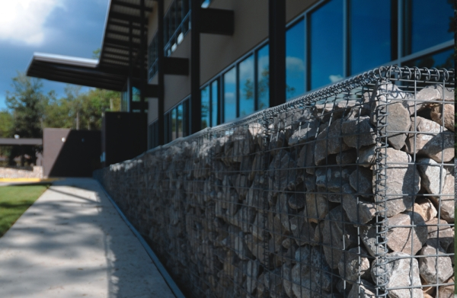
http://www.hesco-usa.com/products/security-barriers
Yet we deploy as a monolith
Huge Java EE container

Slide 7
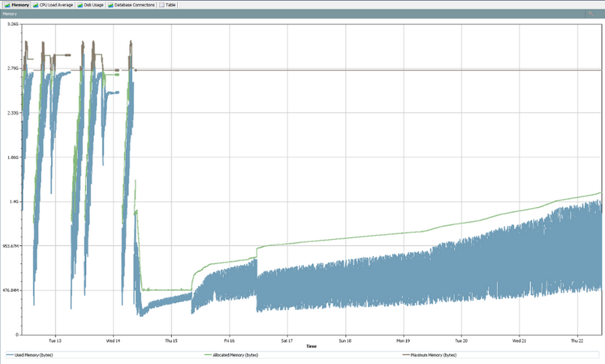
Q: In a monolithic application – where is the memory leak?
Supportability challenges

Slide 8
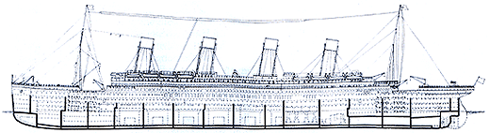
Q: In a monolithic application – what fails when you see OutOfMemoryException?
Reliability challenges
Do you see isolated or catastrophic cascading failure?

Slide 9
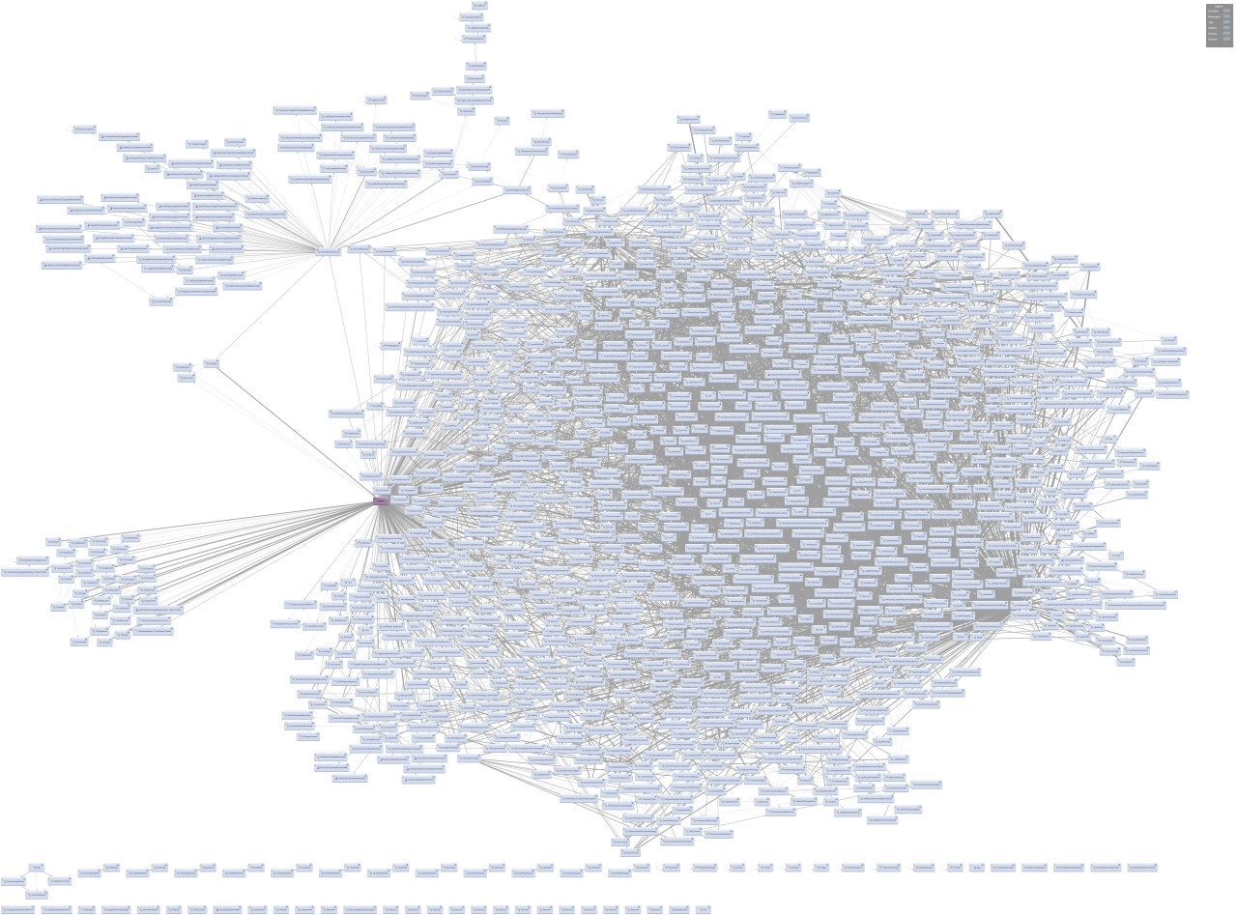
It all starts our great – but oh, what a tangled web we weave
What functional areas need to be regression tested when this class changes?
Too big to fit in my (simple) head!
Complex or Complicated?
Maintainability challenges
Hard to add/upgrade dependencies – leading to stale stacks
Notes:
Hard (risky) to modernize/upgrade dependencies. Scala/Swagger example. 160 jars in WEB-INF/lib – increases chances of incompatibilities.
Simple = Easily understandable
Complicated = Very hard to understand
Ordered = Fully Predictable
Complex = Somewhat predictable
Chaotic = Very unpredictable
Underpants are simple and ordered
A Watch is ordered but complicated
A double pendulum is simple and chaotic
A city is complex and complicated (Atlanta Snowpocalypse)
The stock market is chaotic and complicated

Slide 10
Do monolithic architectures impede Continuous Delivery?
“Adopting Continuous Delivery: Adjusting your Architecture”, Rachel Laycock, Qcon, http://www.infoq.com/presentations/adopting-continuous-delivery

Slide 11
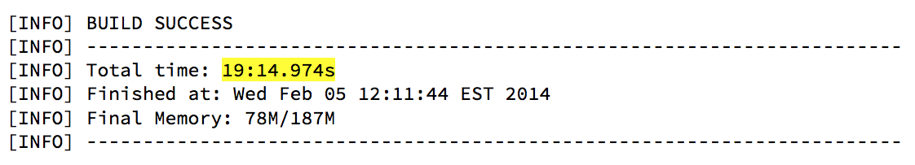
Monolithic applications can take forever to build
Productivity killer

Slide 12
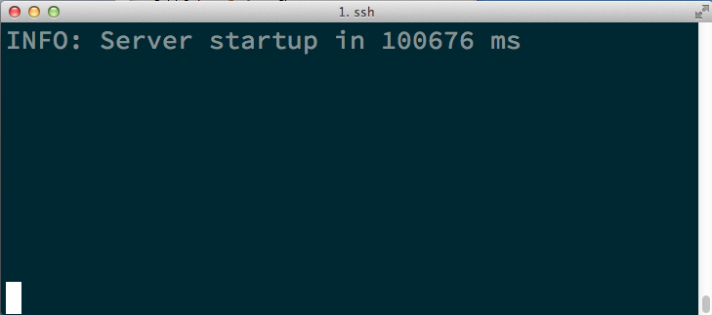
100% unavailable during this time
Availability challenges
Monolithic applications can take forever to get on their feet
Serviceability challenges

Slide 13
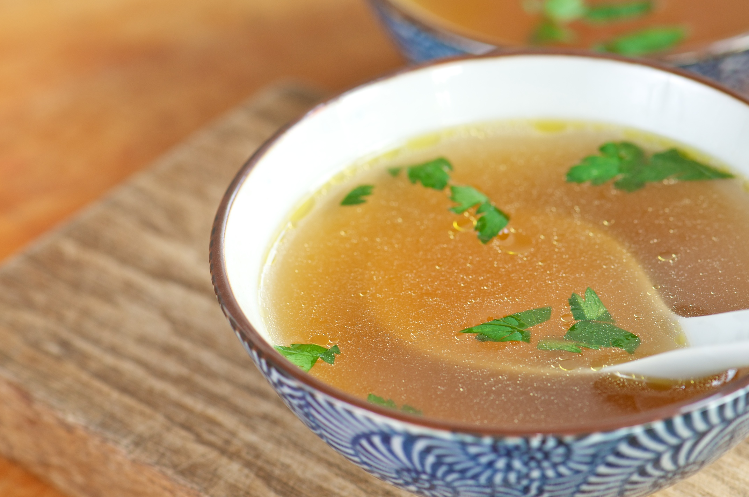
Too many cooks spoil the broth
Impedes ability to scale the team

Slide 14
The challenges of monolithic applications
Supportability
Serviceability
Productivity
Availability
Maintainability
Reliability
Team Growth

Slide 15
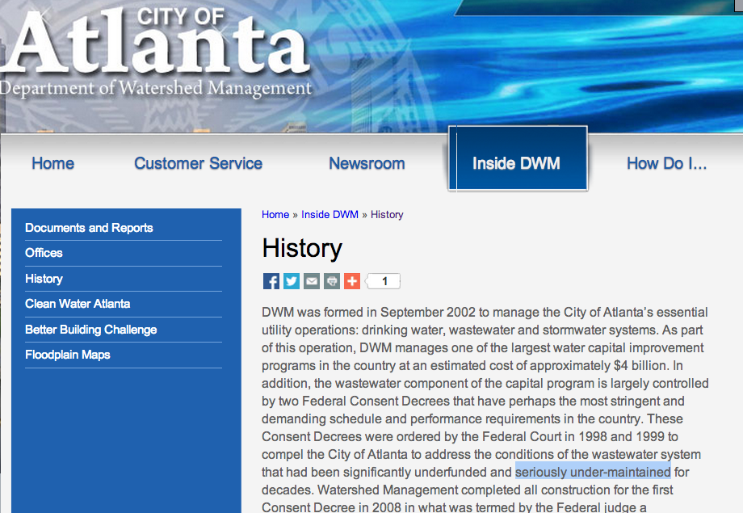
This is just infrastructure stuff – why should we care?

Slide 16
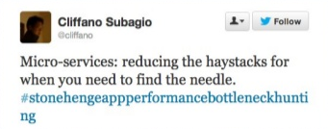
Can micro-services help to address the challenges of monolithic applications?
Notes:
Micro-services moved up from “Assess” to “Trial” inn the ThoughtWorks technology radar between 2012 and 2013.
Trial = “Worth pursuing. It is important to understand how to build up this capability. Enterprises should try this technology on a project that can handle the risk.”

Slide 17
The UNIX philosophy
Write programs that do one thing.. and do it well
Write programs that work together
“Micro Services: Java, the Unix Way", QCon San Francisco 2012, James Lewis
Notes:
Sometimes the clues to the future lie in the past
tr, sort, uniq are all small programs
tr is used to translate characters
sort is self-explanatory
Uniq can be used to report or filter out repeating patterns
They all follow a consistent pattern in that they read input form the standard input channel and output their results to the standard output channel
They are chained together by a pipe | - this feeds the output of one into the input of another
Each program runs in its own process
They each work together and yet they are not coupled to each other.
I could be an expert in sort – but not necessarily an expert in tr

Slide 18
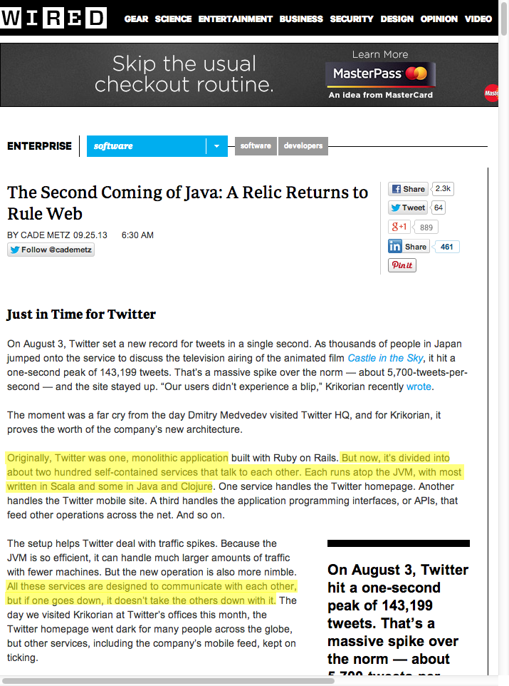
The Micro-services architecture is an approach – the choice of platform and programming language is merely an implementation detail

Slide 19
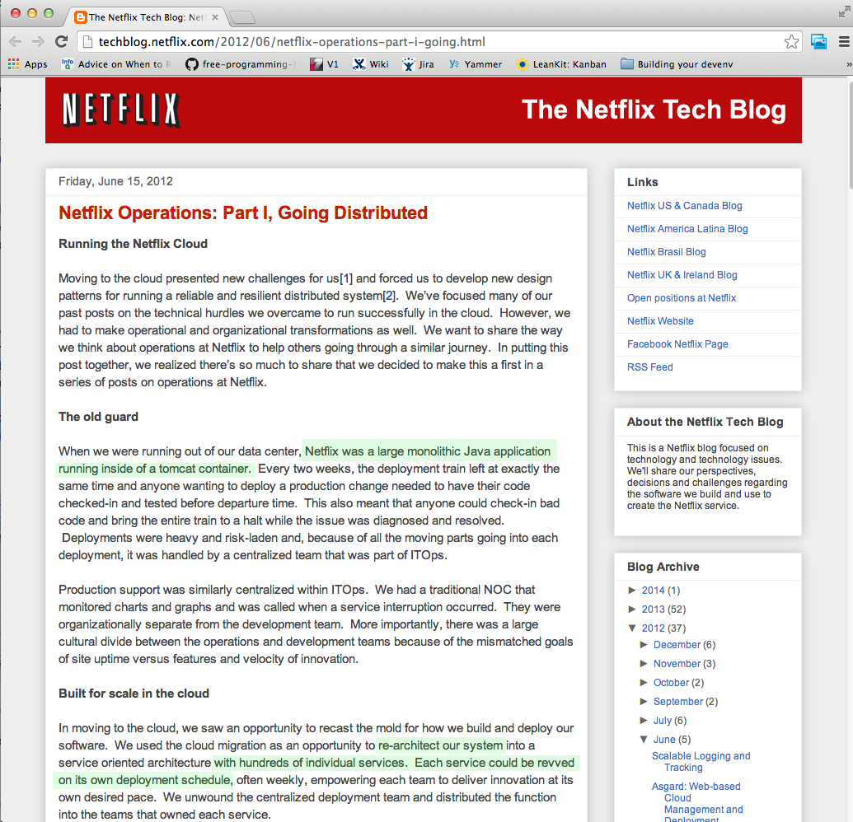
Hmm – looks like Netflix also seem to be moving away from monolithic application structures

Slide 20
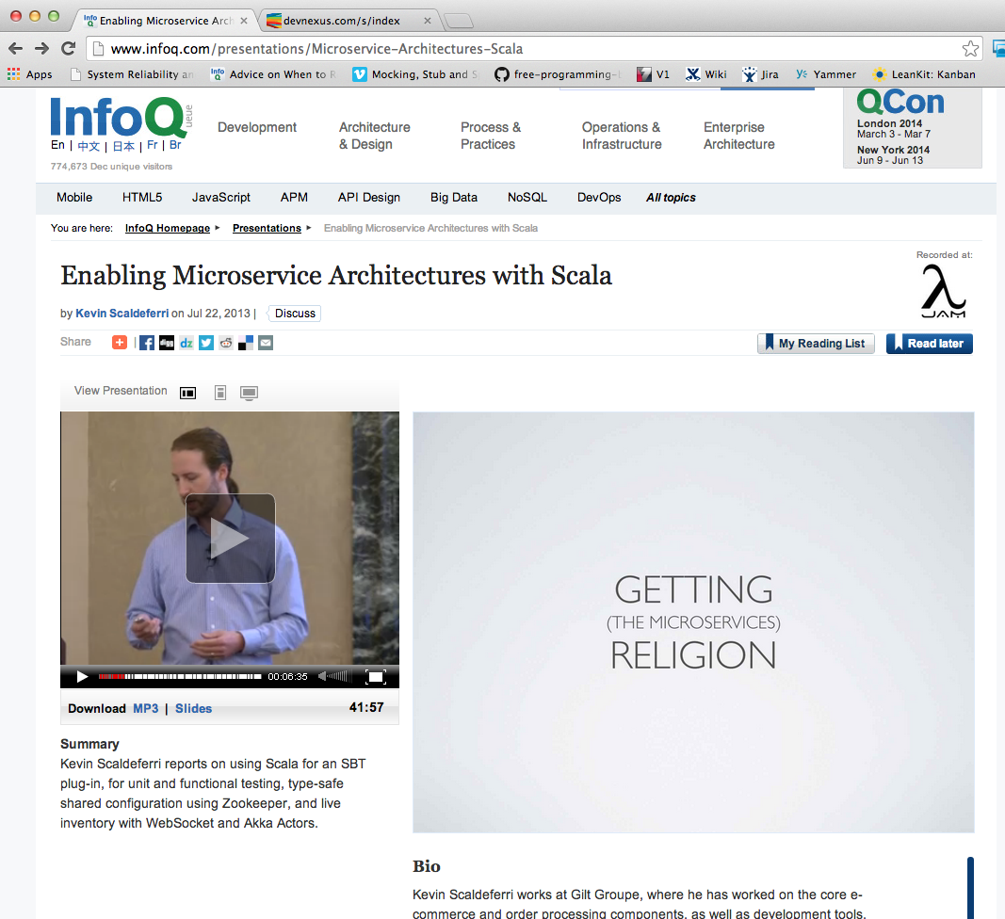
Gilt too!

Slide 21
Large airline website case study
UI layer
Business layer
Data layer
Container
Preflight
Loyalty
Booking
Core
Container
Although we stopped short of micro-services (this was early 2000s) – the result of carving up into smaller chunks delivered significant value
Container
Container

Slide 22
What is a micro-service?
Replaceable
Independent
Runs in its own O/S process (daemon)
Small (enough)
Easily Consumable (HTTP+JSON)
Fast/Easy to startup
Upgrade-able
Free of Temporal coupling
Encapsulation
Forever young
Single Responsibility Principle
Valuable
Testable
Notes:
Small enough to fit in your head.
Small enough to be replaced – Some may say “ < 100 lines”
Replaceable – some may say disposable
Independent - i.e. fails independently “A failure of the on-board entertainment system should not cause engine failure”. Independently versioned – why not?
Runs in it’s own O/S process – yep
Upgrade-able – a by-product of being small and independent
Encapsulation – should be free of side-effects – no sharing underlying data with other services
Single Responsibility Principle – do one thing and one thing well – has one reason to be changed
Testable – a useful by-product of “Independent”, “Encapsulation” and SRP
Valuable – the service needs a reason to exist – it needs to directly or indirectly provide value to the end-user
Forever young – some may say “< 6 months” – “This is really the crux of “Living Software”
Free of Temporal coupling – service a must not be required to start after service b
Fast to startup – reduced impact/higher availability during maintenance

Slide 23
What are the costs of micro-services?
Many processes to manage
Increase in overall memory consumption
Complexity displacement
More moving parts
Operational complexity
Notes:
Small enough to fit in your head.
Small enough to be replaced – Some may say “ < 100 lines”
Replaceable – some may say disposable
Independent - i.e. fails independently “A failure of the on-board entertainment system should not cause engine failure”. Independently versioned – why not?
Runs in it’s own O/S process – yep
Upgrade-able – a by-product of being small and independent
Encapsulation – should be free of side-effects – no sharing underlying data with other services
Single Responsibility Principle – do one thing and one thing well – has one reason to be changed
Testable – a useful by-product of “Independent”, “Encapsulation” and SRP
Valuable – the service needs a reason to exist – it needs to directly or indirectly provide value to the end-user
Forever young – some may say “< 6 months” – “This is really the crux of “Living Software”
Free of Temporal coupling – service a must not be required to start after service b
Fast to startup – reduced impact/higher availability during maintenance

Slide 24
Design considerations
Notes:
Micro-services moved up from “Assess” to “Trial” inn the ThoughtWorks technology radar between 2012 and 2013.
Trial = “Worth pursuing. It is important to understand how to build up this capability. Enterprises should try this technology on a project that can handle the risk.”

Slide 25
“Good OO design principles are equally applicable for the design of micro-services”

Slide 26

Domain-Driven Design (DDD) is complementary to a Micro-services based architecture

Slide 27
“The hardest part is going to be finding the seams in a monolithic application to form the boundaries of the micro-services”

Slide 28
Availability
99.999%
Uptime
Availability =
x 100%
μ-svc-1
Uptime + Downtime
99.999% = 5.26 minutes downtime/year
C
μ-svc-2
μ-svc-3
99.999%
99.999%
Q. What is the overall availability?
= A(μ-svc-1) X A(μ-svc-2) X A(A(μ-svc-3)
= 99.999% X 99.999% X 99.999%
= 99.997% = 15.77 minutes of downtime/year

Slide 29
Availability
 | X | Y | X & Y combined
 | 0.99 | 0.9999 | 0.989901
minutes/year | 525600 | 525600 | 525600
Uptime mins/year | 520344 | 525547.44 | 520291.9656
Downtime mins/year | 5256 | 52.56 | 5308.0344
Downtime days/year | 3.65 | 0.0365 | 3.686135
A = A_{x} A_{y}
X
Y
X
 | X | 2x X | 3x X
 | 0.99 | 0.9999 | 0.999999
minutes/year | 525600 | 525600 | 525600
Uptime mins/year | 520344 | 525547.44 | 525599.4744
Downtime seconds/year | 315360 | 3153.6 | 31.536
Downtime mins/year | 5256 | 52.56 | 0.5256
Downtime days/year | 3.65 | 0.0365 | 0.000365
X
A = 1-(1-A_{x} )²

Slide 30
“Overall availability is reduced with each dependency. With micro-services the number of dependencies may increase.”

Slide 31






Micro-services working together
μ-svc-1
μ-svc-2
Avoid synchronous RPC calls – why?
RPC
call
If you feel you need to do this, first ask – did I get the boundaries right?
μ-svc-1
RPC
μ-svc-2
If you still feel you need to do this, then consider a circuit breaker (e.g. Netflix Hystrix)
call
μ-svc-1
μ-svc-2
Prefer async pub/sub – why?
pub
sub
Apache Kafka may be worth looking into as a messaging backbone

Slide 32
Securing micro-services
Proxy
Consider fronting the micro-services with a proxy (with a circuit breaker)
Maybe you want to control access
μ-svc-1
μ-svc-2
Maybe you need to invoke the services from a web client
μ-svc-3
μ-svc-4
Maybe you want to avoid having to open more holes in the firewall

Slide 33
Don’t let your micro-services turn into this!
Complexity displacement!!

Slide 34
Blueprint?
Maybe licensing is handled in the proxy too
Services with a single responsibility of providing integration point
Proxy
μ-svc-n
Each services has built-in diagnostics and performance monitoring capabilities
Encapsulation – eliminates side-effects
Circuit Breakers to avoid cascading failure
μ-svc-1
μ-svc-2
μ-svc-3
Databases
Each service has its own config set and log location to avoid stepping on the toes of other services
pub
sub
Each service has it’s own automated regression test suite
Messaging Backbone
Async messaging backbone provides loosely-coupled way for services to work together – like | (pipe)
Services tuned individually – allocate only what they need
Each service can be tested/versioned/released independently

Slide 35
Execution considerations
Notes:
Micro-services moved up from “Assess” to “Trial” inn the ThoughtWorks technology radar between 2012 and 2013.
Trial = “Worth pursuing. It is important to understand how to build up this capability. Enterprises should try this technology on a project that can handle the risk.”

Slide 36
For existing projects, carve off micro-services incrementally – avoid big-bang
Use whatever language/platform you are comfortable with today
.. as long as it meets “your” definition of what micro-services are
Polyglot (be careful of Polyglut)

Slide 37
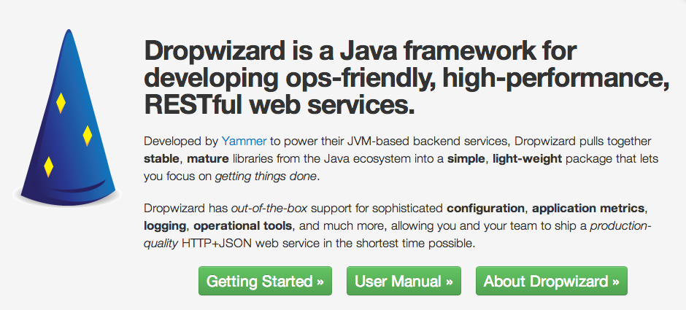
Something like Dropwizard can help you get started quickly with a Java based implementation of micro-services

Slide 38

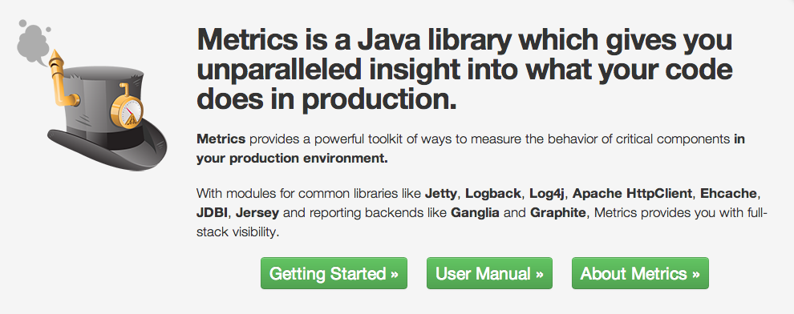
Something like this can help with performance monitoring

Slide 39
close()
Notes:
Micro-services moved up from “Assess” to “Trial” inn the ThoughtWorks technology radar between 2012 and 2013.
Trial = “Worth pursuing. It is important to understand how to build up this capability. Enterprises should try this technology on a project that can handle the risk.”

Slide 40
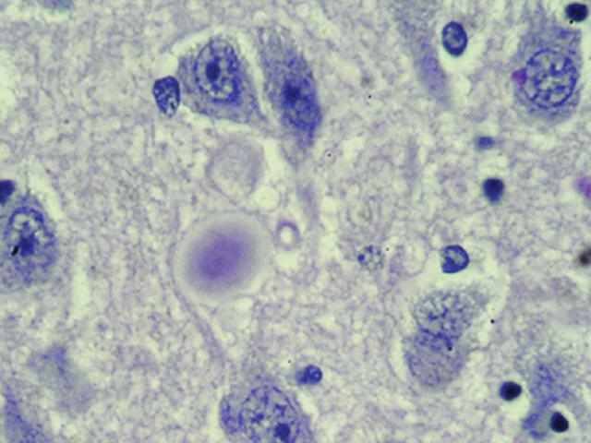
Micro-services
Microbiology
Continuous delivery
Brain cells
Regeneration
Renewal
Regeneration
Living software?
An end to Legacy software?
http://www.genome.gov/dmd/img.cfm?node=Photos/Technology/Cells%20and%20biological%20pathways&id=79194

Slide 41
“If you look after the pennies, the pounds will look after themselves.”

Slide 42
Further Reading
“The Second Coming of Java: A Relic Returns to Rule Web", Wired, Cade Metz, September 2013, http://www.wired.com/wiredenterprise/2013/09/the-second-coming-of-java/2/
“Micro Services: Java, the Unix Way", QCon San Francisco 2012, James Lewis http://www.infoq.com/presentations/Micro-Services
“GOTO Berlin: Microservices as an Alternative to Monoliths", InfoQ, Jan Stenberg, October 2013 http://www.infoq.com/news/2013/10/goto-ber-microservices
“Domain-Driven Design: Tackling Complexity in the Heart of Software”, Addison-Wesley, Eric Evans, August 2003 http://www.amazon.com/Domain-Driven-Design-Tackling-Complexity-Software/dp/0321125215
"Baruco 2012: Micro-Service Architecture", Fred George, November 2012 http://www.youtube.com/watch?v=2rKEveL55TY
“Enabling Microservice Architectures with Scala “, Kevin Scaldeferri (Gilt), Jul 22 2013 http://www.infoq.com/presentations/Microservice-Architectures-Scala
“Adopting Continuous Delivery: Adjusting your Architecture”, Rachel Laycock, Qcon, http://www.infoq.com/presentations/adopting-continuous-delivery
http://yobriefca.se/blog/2013/04/29/micro-service-architecture/
Dropwizard, http://dropwizard.codahale.com/
Metrics, http://metrics.codahale.com/
Netflix Hystrix, https://github.com/Netflix/Hystrix
Apache Kafka, https://kafka.apache.org/
System Reliability and Availability http://www.eventhelix.com/realtimemantra/faulthandling/system_reliability_availability.htm#.UtASOGRDuAR
City of Atlanta Department of Watershed Management history http://www.atlantawatershed.org/inside-dwm/history/

Slide 43
THANK
YOU
Jason Chambers
Director of Engineering

